Slide 1


Assessment of Warm and Cold Storages for Azure Internet of Things Seminar: Techniques and Methods of Software Performance Management in Internet of Things
Minh Vu
Munich, 06.07.2020
1
06.07.20
Assessment of Warm and Cold Storages for Azure Internet of Things

Slide 2

Philosophy of Azure IoT
3 Pillars
Things | Insights | Actions
Sensors | Visualizations | Commands
Machines | Predictive Analytics | Tweaking Parameters
2
06.07.20
Assessment of Warm and Cold Storages for Azure Internet of Things

Slide 3
Philosophy of Azure IoT
3 Pillars
Things | Insights | Actions
Sensors | Visualizations | Commands
Machines | Predictive Analytics | Tweaking Parameters
3
06.07.20
Assessment of Warm and Cold Storages for Azure Internet of Things

Slide 4
Philosophy of Azure IoT
3 Pillars
Things | Insights | Actions
Sensors | Visualizations | Commands
Machines | Predictive Analytics | Tweaking Parameters
4
06.07.20
Assessment of Warm and Cold Storages for Azure Internet of Things

Slide 5
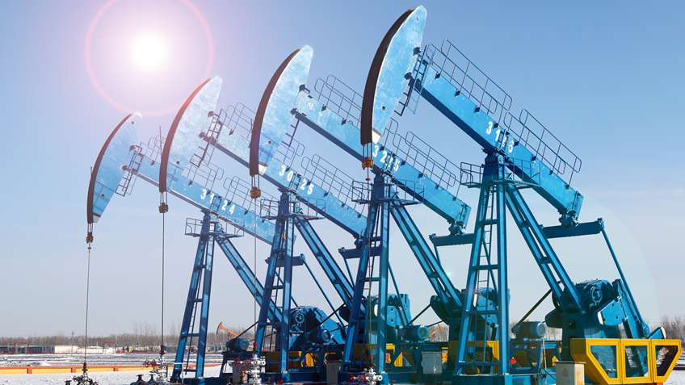

Application
Manufacturing: Oil industry
Assessment of Warm and Cold Storages for Azure Internet of Things
5
06.07.20

Slide 6
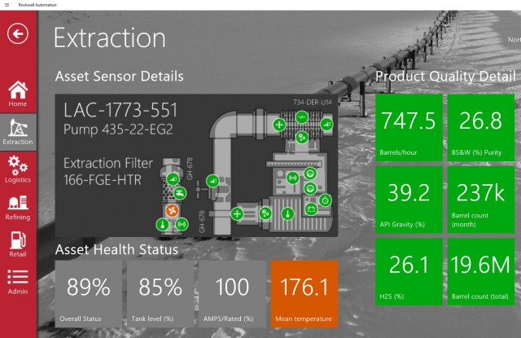
Assessment of Warm and Cold Storages for Azure Internet of Things
6

Slide 7
Things
Assessment of Warm and Cold Storages for Azure Internet of Things
7

Slide 8
Things
Assessment of Warm and Cold Storages for Azure Internet of Things
8

Slide 9
Long-Term Insights
Things
Assessment of Warm and Cold Storages for Azure Internet of Things
9

Slide 10
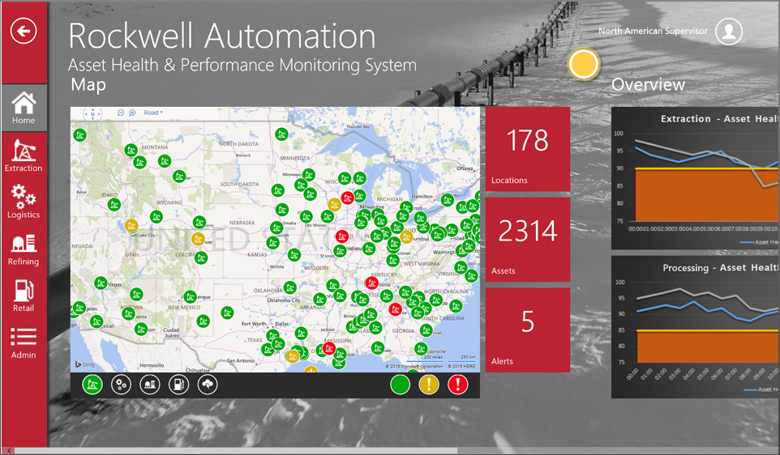
Assessment of Warm and Cold Storages for Azure Internet of Things
10

Slide 11
Critical Alerts
Assessment of Warm and Cold Storages for Azure Internet of Things
11

Slide 12
Big Data: A Dilemma
Real-Time Events | Long-Term Archive
Fast Storage | Long-Term Storage
Low Latency | High Latency
Compressed | Full Accuracy
Critical Reaction | Batch Analytics
Assessment of Warm and Cold Storages for Azure Internet of Things
12

Slide 13
Big Data: A Dilemma
Real-Time Events | Long-Term Archive
Fast Storage | Long-Term Storage
Low Latency | High Latency
Compressed | Full Accuracy
Critical Reaction | Batch Analytics
Assessment of Warm and Cold Storages for Azure Internet of Things
13

Slide 14
Big Data: A Dilemma
Real-Time Events | Long-Term Archive
Fast Storage | Long-Term Storage
Low Latency | High Latency
Compressed | Full Accuracy
Critical Reaction | Batch Analytics
Assessment of Warm and Cold Storages for Azure Internet of Things
14

Slide 15
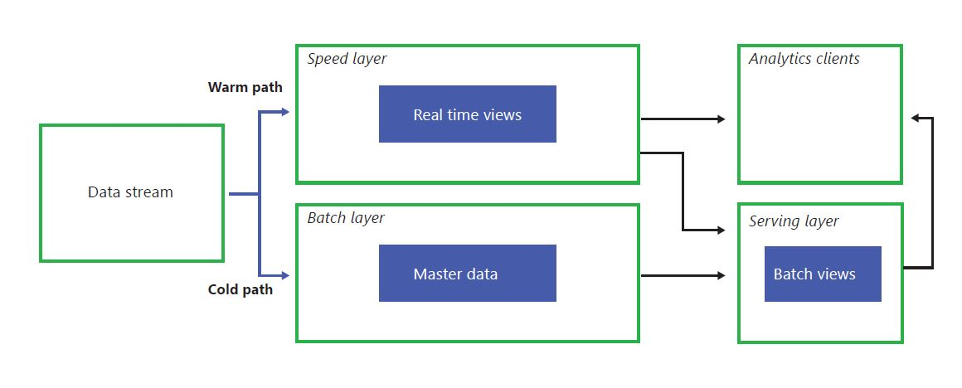
Lambda Architecture
Warm Path, for Real-Time Views
Cold Path, for Long-Term Archive
Assessment of Warm and Cold Storages for Azure Internet of Things
15

Slide 16
Lambda Architecture
Warm Path, for Real-Time Views
Cold Path, for Long-Term Archive
Assessment of Warm and Cold Storages for Azure Internet of Things
16

Slide 17

Warm Storages
Azure Cosmos DB: All-Rounder
Azure SQL DB: Relational Data
Azure Time Series Insights: Data Analytics
Assessment of Warm and Cold Storages for Azure Internet of Things
17

Slide 18

Warm Storages
Azure Cosmos DB: All-Rounder
Azure SQL DB: Relational Data
Azure Time Series Insights: Data Analytics
Assessment of Warm and Cold Storages for Azure Internet of Things
18

Slide 19

Warm Storages
Azure Cosmos DB: All-Rounder
Azure SQL DB: Relational Data
Azure Time Series Insights: Data Analytics
Assessment of Warm and Cold Storages for Azure Internet of Things
19

Slide 20
Criteria for Warm Storages
Security
Simplicity
Performance
Scalability
Query Capability
Price
Assessment of Warm and Cold Storages for Azure Internet of Things
20

Slide 21
Criteria for Warm Storages
Security
Simplicity
Performance
Scalability
Query Capability
Price
Assessment of Warm and Cold Storages for Azure Internet of Things
21

Slide 22
Criteria for Warm Storages
Security
Simplicity
Performance
Scalability
Query Capability
Price
Assessment of Warm and Cold Storages for Azure Internet of Things
22

Slide 23
 | Azure Cosmos DB | Azure SQL DB | Azure Time Series Insights
Data Model | Multi-Model | Relational | Time-Series
Availability | 99.99% SLA | 99.99% SLA | 99.90% SLA
Data retention time | 1 Month | Built-in swap 10 years with Cold Storage | 13 Months
Data Limits | Unlimited | Max 4TB | Max 3TB
Throughput Limits | 1,000,000 Request Units/s | Max 4000 Database Transaction Units/ Database | Unknown
Pricing Model | Storage Usage and RUs | Storage and DTUs or vCores | Storage, Daily Ingress and Queries
Assessment of Warm and Cold Storages for Azure Internet of Things
23

Slide 24
 | Azure Cosmos DB | Azure SQL DB | Azure Time Series Insights
Data Model | Multi-Model | Relational | Time-Series
Availability | 99.99% SLA | 99.99% SLA | 99.90% SLA
Data retention time | 1 Month | Built-in swap 10 years with Cold Storage | 13 Months
Data Limits | Unlimited | Max 4TB | Max 3TB
Throughput Limits | 1,000,000 Request Units/s | Max 4000 Database Transaction Units/ Database | Unknown
Pricing Model | Storage Usage and RUs | Storage and DTUs or vCores | Storage, Daily Ingress and Queries
Assessment of Warm and Cold Storages for Azure Internet of Things
24

Slide 25
 | Azure Cosmos DB | Azure SQL DB | Azure Time Series Insights
Data Model | Multi-Model | Relational | Time-Series
Availability | 99.99% SLA | 99.99% SLA | 99.90% SLA
Data retention time | 1 Month | Built-in swap 10 years with Cold Storage | 13 Months
Data Limits | Unlimited | Max 4TB | Max 3TB
Throughput Limits | 1,000,000 Request Units/s | Max 4000 Database Transaction Units/ Database | Unknown
Pricing Model | Storage Usage and RUs | Storage and DTUs or vCores | Storage, Daily Ingress and Queries
Assessment of Warm and Cold Storages for Azure Internet of Things
25

Slide 26
Request Units: Database Currency
Metric for Azure Cosmos DB
Simplifies database Performance
CPU Power + Memory + IOPS = Operations
RUs/second as currency for Throughput
Assessment of Warm and Cold Storages for Azure Internet of Things
26

Slide 27
Request Units: Database Currency
Metric for Azure Cosmos DB
Simplifies database Performance
CPU Power + Memory + IOPS = Operations
RUs/second as currency for Throughput
Assessment of Warm and Cold Storages for Azure Internet of Things
27

Slide 28
Request Units: Database Currency
Metric for Azure Cosmos DB
Simplifies database Performance
CPU Power + Memory + IOPS = Operations
RUs/second as currency for Throughput
Assessment of Warm and Cold Storages for Azure Internet of Things
28

Slide 29
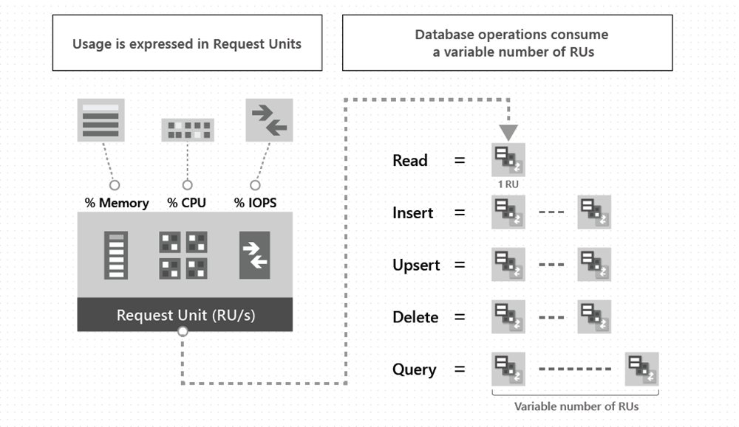
Request Units: Database Currency
Assessment of Warm and Cold Storages for Azure Internet of Things
29

Slide 30
Request Units: Database Currency
Assessment of Warm and Cold Storages for Azure Internet of Things
30

Slide 31
Request Units Considerations
Larger Size > More RUs
Strong & bounded staleness Consistency > 2x more RUs at Read
Index more Items > More RUs
Index more Properties > More RUs
Deeper property Hierarchies > More RUs
More complex Queries > More RUs
More script Usages > More RUs
Assessment of Warm and Cold Storages for Azure Internet of Things
31

Slide 32
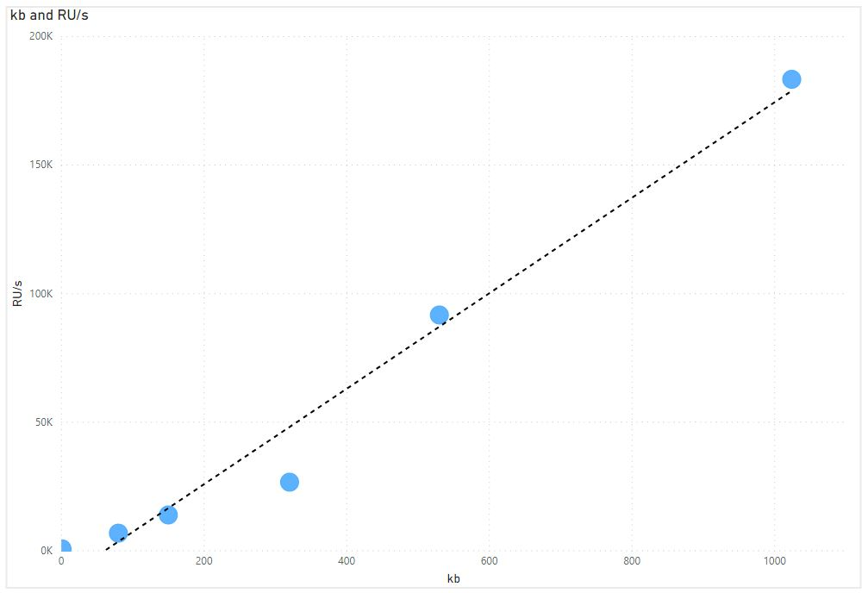
Larger Size > More RUs
Assessment of Warm and Cold Storages for Azure Internet of Things
32

Slide 33
Request Units Considerations
Larger Size > More RUs
Strong & bounded staleness Consistency > 2x more RUs at Read
Index more Items > More RUs
Index more Properties > More RUs
Deeper property Hierarchies > More RUs
More complex Queries > More RUs
More script Usages > More RUs
Assessment of Warm and Cold Storages for Azure Internet of Things
33

Slide 34
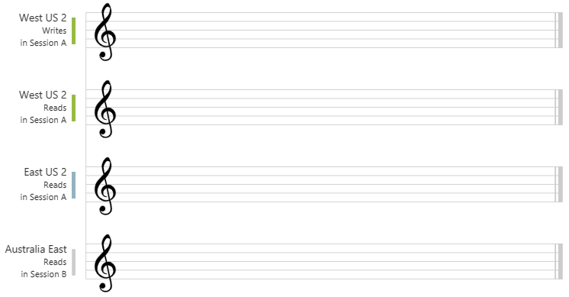
Strong Consistency > 2x more RUs at Read
Session (default): Within a client session, reads are consistent-prefix. Monotonic read, monotonic writes, read your writes, write your reads
Assessment of Warm and Cold Storages for Azure Internet of Things
34

Slide 35
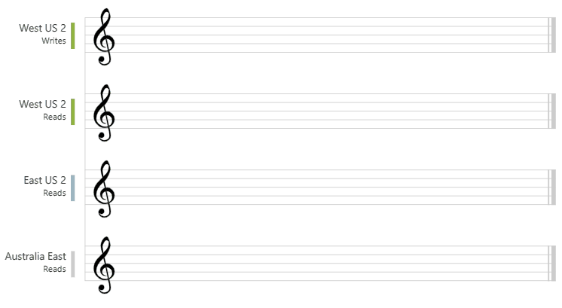
Strong Consistency > 2x more RUs at Read
Strong: Clients never see partial W, Users read latest W
Assessment of Warm and Cold Storages for Azure Internet of Things
35

Slide 36
Request Units Considerations
Larger Size > More RUs
Strong & bounded staleness Consistency > 2x more RUs at Read
Index more Items > More RUs
Index more Properties > More RUs
Deeper property Hierarchies > More RUs
More complex Queries > More RUs
More script Usages > More RUs
Assessment of Warm and Cold Storages for Azure Internet of Things
36

Slide 37
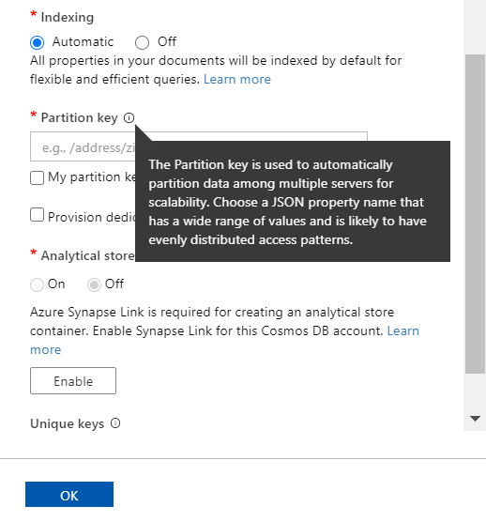
Reduce RUs with Partition Keys
Partition Keys
Assessment of Warm and Cold Storages for Azure Internet of Things
37

Slide 38
Reduce RUs with Partition Keys
Property with unchanged value: Location or Customer ID.
Assessment of Warm and Cold Storages for Azure Internet of Things
38

Slide 39
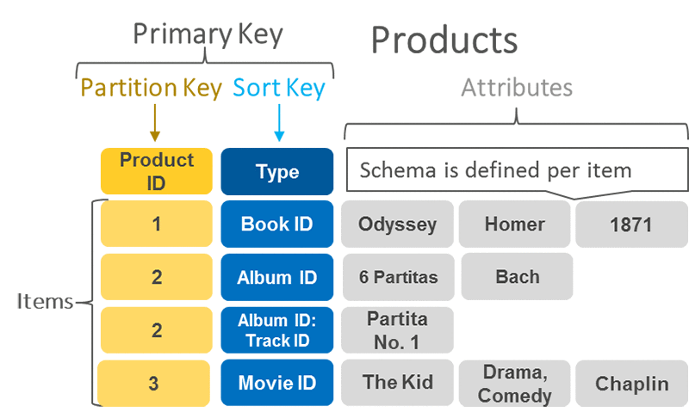
Reduce RUs with Partition Keys
Property with unchanged value: Location or Customer ID.
Assessment of Warm and Cold Storages for Azure Internet of Things
39

Slide 40
Reduce RUs with Partition Keys
Property with unchanged value: Location or Customer ID.
Assessment of Warm and Cold Storages for Azure Internet of Things
40

Slide 41
Reduce RUs with Partition Keys
Partition Keys: How Cosmos DB distributes your Data.
Assessment of Warm and Cold Storages for Azure Internet of Things
41

Slide 42
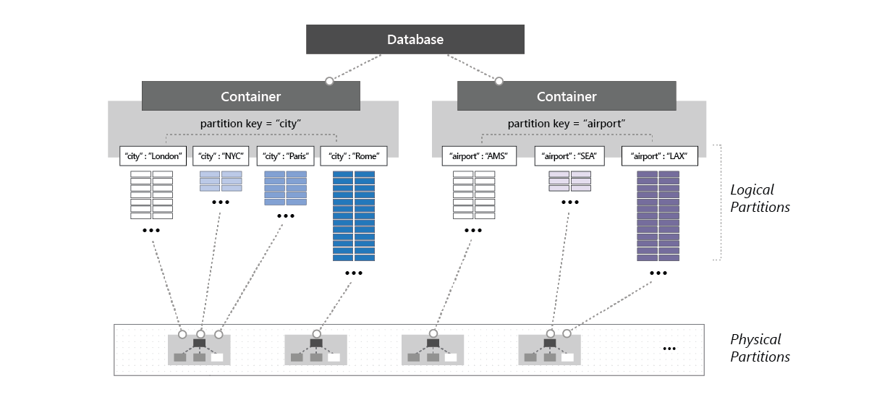
Reduce RUs with Partition Keys
Partition Keys: How Cosmos DB distributes your Data.
Assessment of Warm and Cold Storages for Azure Internet of Things
42

Slide 43
Reduce RUs with Partition Keys
Partition Keys: How Cosmos DB distributes your Data.
Assessment of Warm and Cold Storages for Azure Internet of Things
43

Slide 44
Reduce RUs with Partition Keys
Partition Keys: How Cosmos DB distributes your Data.
Diversified
Assessment of Warm and Cold Storages for Azure Internet of Things
44

Slide 45
Reduce RUs with Partition Keys
Heuristic for Partition Keys
Assessment of Warm and Cold Storages for Azure Internet of Things
45

Slide 46
Reduce RUs with Partition Keys
Heuristic for Partition Keys
Unique as possible
Assessment of Warm and Cold Storages for Azure Internet of Things
46

Slide 47
Request Units Considerations
Larger Size > More RUs
Strong & bounded staleness Consistency > 2x more RUs at Read
Index more Items > More RUs
Index more Properties > More RUs
Deeper property Hierarchies > More RUs
More complex Queries > More RUs
More script Usages > More RUs
Assessment of Warm and Cold Storages for Azure Internet of Things
47

Slide 48
Database Transaction Units (SQL)
Metric for Azure SQL Database
CPU Power + Memory + Reads + Writes
Assessment of Warm and Cold Storages for Azure Internet of Things
48

Slide 49
Database Transaction Units (SQL)
Metric for Azure SQL Database
CPU Power + Memory + Reads + Writes
Assessment of Warm and Cold Storages for Azure Internet of Things
49

Slide 50
Database Transaction Units (SQL)
Metric for Azure SQL Database
CPU Power + Memory + Reads + Writes
Assessment of Warm and Cold Storages for Azure Internet of Things
50

Slide 51

Cold Storages
Azure Blob Storage: Large Objects
Azure Data Lake Storage Gen2: Data Analytics
Assessment of Warm and Cold Storages for Azure Internet of Things
51

Slide 52

Cold Storages
Azure Blob Storage: Large Objects
Azure Data Lake Storage Gen2: Data Analytics
Assessment of Warm and Cold Storages for Azure Internet of Things
52

Slide 53
Criteria for Cold Storages
Security
Simplicity
Scalability
Price
Assessment of Warm and Cold Storages for Azure Internet of Things
53

Slide 54
Criteria for Cold Storages
Security
Simplicity
Scalability
Price
Assessment of Warm and Cold Storages for Azure Internet of Things
54

Slide 55
 | Azure Blob Storage | Azure Data Lake Storage Gen2
Data Model | Object store with flat namespace | Hierarchical File System
Availability | 99.90% SLA for R/W | 99.90% SLA for R/W
Data Limits | 5 PiB | None
Throughput Limits | 20,000 Requests/second | None
Pricing Model | Data Usage and Request Count | Data Usage and Request Count
Assessment of Warm and Cold Storages for Azure Internet of Things
55

Slide 56
 | Azure Blob Storage | Azure Data Lake Storage Gen2
Data Model | Object store with flat namespace | Hierarchical File System
Availability | 99.90% SLA for R/W | 99.90% SLA for R/W
Data Limits | 5 PiB | None
Throughput Limits | 20,000 Requests/second | None
Pricing Model | Data Usage and Request Count | Data Usage and Request Count
Assessment of Warm and Cold Storages for Azure Internet of Things
56

Slide 57
The case for Cold
Retention period
 | Azure Cosmos DB | Azure SQL DB | Azure Time Series Insights
Data retention time | 1 Month | Built-in swap 10 years with Blob Storage | 13 Months
Assessment of Warm and Cold Storages for Azure Internet of Things
57

Slide 58
The case for Cold
Retention period
 | Azure Cosmos DB | Azure SQL DB | Azure Time Series Insights
Data retention time | 1 Month | Built-in swap 10 years with Blob Storage | 13 Months
Assessment of Warm and Cold Storages for Azure Internet of Things
58

Slide 59
The case for Cold
Retention period
 | Azure Cosmos DB | Azure SQL DB | Azure Time Series Insights
Data retention time | 1 Month | Built-in swap 10 years with Blob Storage | 13 Months
Assessment of Warm and Cold Storages for Azure Internet of Things
59

Slide 60
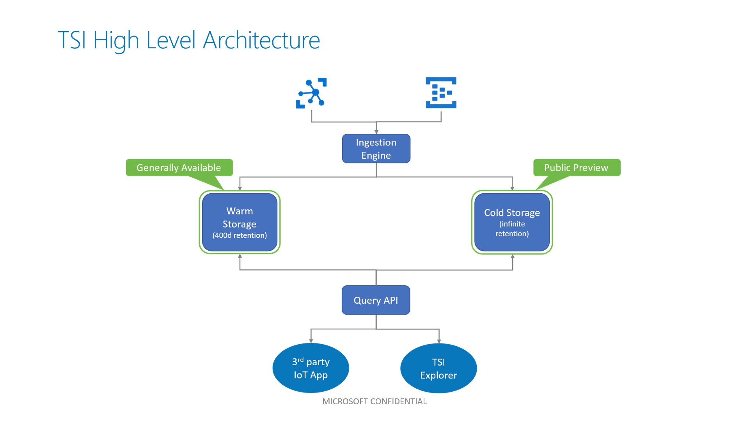
Data Source
Assessment of Warm and Cold Storages for Azure Internet of Things
60

Slide 61
Data Source
Assessment of Warm and Cold Storages for Azure Internet of Things
61

Slide 62
Queries
Assessment of Warm and Cold Storages for Azure Internet of Things
62

Slide 63
Queries
Assessment of Warm and Cold Storages for Azure Internet of Things
63

Slide 64
Comparing Christmas Sales
You have a shop
Compare Sales at Christmas holiday
Query with Time Series Insights
Assessment of Warm and Cold Storages for Azure Internet of Things
64

Slide 65
Comparing Christmas Sales
You have a shop
Compare Sales at Christmas holiday
Query with Time Series Insights
Assessment of Warm and Cold Storages for Azure Internet of Things
65

Slide 66
Comparing Christmas Sales
You have a shop
Compare Sales at Christmas holiday
Query with Time Series Insights
Assessment of Warm and Cold Storages for Azure Internet of Things
66

Slide 67
Comparing Christmas Sales
You have a shop
Compare Sales at Christmas holiday
Query with Time Series Insights
Assessment of Warm and Cold Storages for Azure Internet of Things
67

Slide 68
Comparing Christmas Sales
Sales DB
Assessment of Warm and Cold Storages for Azure Internet of Things
68

Slide 69
Comparing Christmas Sales
Sales DB
Time Series Insights
Assessment of Warm and Cold Storages for Azure Internet of Things
69

Slide 70
Comparing Christmas Sales
Sales DB
Time Series Insights
Assessment of Warm and Cold Storages for Azure Internet of Things
70

Slide 71
Comparing Christmas Sales
Sales DB
Time Series Insights
Christmas Sales
Assessment of Warm and Cold Storages for Azure Internet of Things
71

Slide 72
Comparing Christmas Sales
Sales DB
Time Series Insights
Christmas Sales
Assessment of Warm and Cold Storages for Azure Internet of Things
72

Slide 73
Comparing Christmas Sales
Sales DB
Time Series Insights
Christmas Sales
Queries
Assessment of Warm and Cold Storages for Azure Internet of Things
73

Slide 74
Storages: An Overview
Warm Storages | Cold Storages
Short Retention | Long Retention
Laxer Consistency | Stricter Consistency
Limited Space | Unlimited Space
Optimized for Speed | Optimized for Robustness
Assessment of Warm and Cold Storages for Azure Internet of Things
74

Slide 75
Storages: An Overview
Warm Storages | Cold Storages
Shorter Retention | Longer Retention
Laxer Consistency | Stricter Consistency
Limited Space | Unlimited Space
Optimized for Speed | Optimized for Robustness
Assessment of Warm and Cold Storages for Azure Internet of Things
75

Slide 76
Takeaways
Warm Path – Cold Path
Request Units to quantify performance
Trade-offs with Consistency, Retention and Space
Assessment of Warm and Cold Storages for Azure Internet of Things
76

Slide 77
Takeaways
Warm Path – Cold Path
Request Units to quantify performance
Trade-offs with Consistency, Retention and Space
Assessment of Warm and Cold Storages for Azure Internet of Things
77

Slide 78
Takeaways
Warm Path – Cold Path
Request Units to quantify performance
Trade-offs with Consistency, Retention and Space
Assessment of Warm and Cold Storages for Azure Internet of Things
78

Slide 79
References
Azure IoT reference architecture
Solution guide: Extracting Insights from IoT
Fueling the oil and gas industry with IoT
Increase equipment reliability with predictive maintainence
Azure Cosmos DB documentation
Azure SQL DB documentation
Azure Time Series Insights Documentation
Azure Blob Storage Documentation
Azure Data Lake Storage Gen2 Documentation
Request Units in Azure Cosmos DB
Consistency levels in Azure Cosmos DB
Azure Cosmos DB Capacity Calculator
Service Tiers in the DTU-based purchase model
Choosing the right Dynamo DB Partition Key
Introduction to provisioned throughput in Azure Cosmos DB
Assessment of Warm and Cold Storages for Azure Internet of Things
79

Slide 80

Thank you.
Questions?
Assessment of Warm and Cold Storages for Azure Internet of Things
80
80
06.07.20
<TITLE>

